Slide 1
IPW for non-binary exposures
Sarah Ruth Hoffman
April 08, 2019
Pharmacoepidemiology Seminar
Notes:
“Inverse probability weighting for non-binary exposure in SAS with practice example in Excel."

Slide 2

A Journey within a Journey…!

Slide 3
Levels
Degree program
Dissertation
Aim 2
IPW Models
Rabbit Hole 1
Rabbit Hole 1a
Rabbit Hole 2…
∞
You are Here.

Slide 4
Updates
Last presented January 14, 2019 (83 days ago)
Got as far as PS curves
February ~27, 2019 first complete, successful run!
MJF Research Group suggested Excel experiment to compare SAS to hand calculations
GitHub: https://github.com/srhoffma/non_binary_exposure_IPW

Slide 5
The most important question
What do I not know?
Notes:
Small helpful things come along the way. You’ll notice them because the questions will be on your mind and you will be attuned and receptive to the answers.

Slide 6
Why IPW?
Enhanced interpretability
Fit more covariates
Transparent (can look at covariate balance)
Notes:
As opposed to conditional model
No comment on the philosophy, as that is another presentation altogether
Focus on the mechanics

Slide 7
What do I need to do this?
IPW normally taught in binary exposures
No leads on how to do this for non-binary exposures
Not something I have seen before
Notes:
When somebody gives me a task, my next thought is… Gaps… To be fair…2015

Slide 8
Three Resources
Literature, including code and class notes
Other minds at UNC and beyond
What SAS gives me/Empiricism/Actually doing
Notes:
Literature, other people, and experience (Trial & Error).
SER conference

Slide 9
EPID 722: Brookhart Code Steps
Create a PS model
Plot the overlap of the PS distributions by treatment group
Compute weights
Output weighted and unweighted Table 1
Weighted linear regression for final estimate
Notes:
PS = propensity score

Slide 10
Presenting SAS Code Alongside Excel Example
Notes:
As not to get caught up in the nuances of the real life data, using Excel cohort!

Slide 12
SAS Code Steps
Frequency tables
Crude model
PS model
PS curves
Calculate weights
Examine distribution of weights
Examine covariate balance
Weighted models
Conventional multiple regression model
Outputs ~50 page RTF

Slide 13
Defining Success
Stabilized weights average ~1
Weighted estimates similar to MVR results
Sensible covariate balance (e.g., SMD < 0.05)
Sum of weights = Sample size x Number of treatment groups
Sum of stabilized weights = Sample size
Notes:
Standardized mean difference

Slide 14
So… What are the weights?
Assuming we want ATE
All people trt 1 vs all people trt 0
All people trt 2 vs all people trt 0
[…]
PS = P(trt_{obs}|covariates)
In binary exposure setting, PS given as P(trt=1|covariates)
IPW = 1/PS = 1/P(trt_{obs}|covariates)
In binary exposure setting, untreated IPW often given as 1/(1-PS)
S_IPW = P(trt_{obs})/P(trt_{obs}|covariates)
Notes:
1/the propensity for getting what I got.
The ipw's were the inverse probability of the person's observed exposure given their covariate values [inverse of their propensity score for their actual/observed treatment]. The stabilized ipw's were the marginal probability of the observed exposure divided by the probability of the observed exposure given their covariate values.

Slide 15
What model to estimate PS’s?
Multinomial logistic regression
SAS output implications
Where i = number of trt groups
Cumulative logit yields i-1 estimates per person
Multinomial logistic reg. yields i estimates per person
Data gymnastics
PROC LOGISTIC output data set has i rows per person
Tell SAS which PS’s to plot
Tell SAS which PS to use to calculate S/IPW

Slide 16
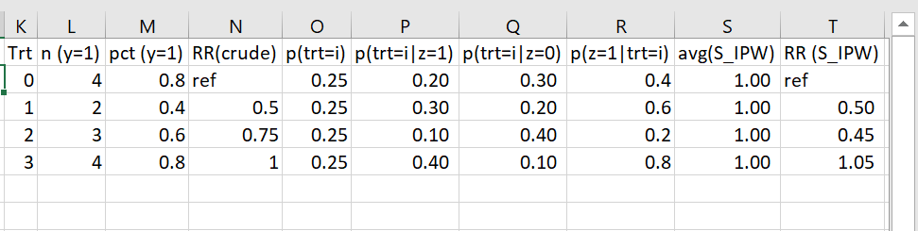
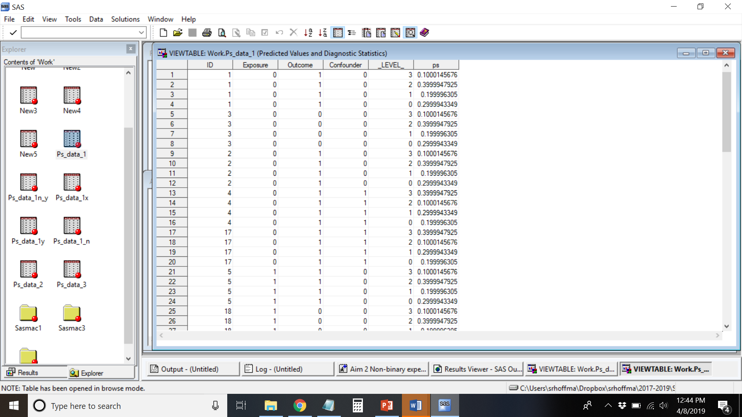

Slide 18
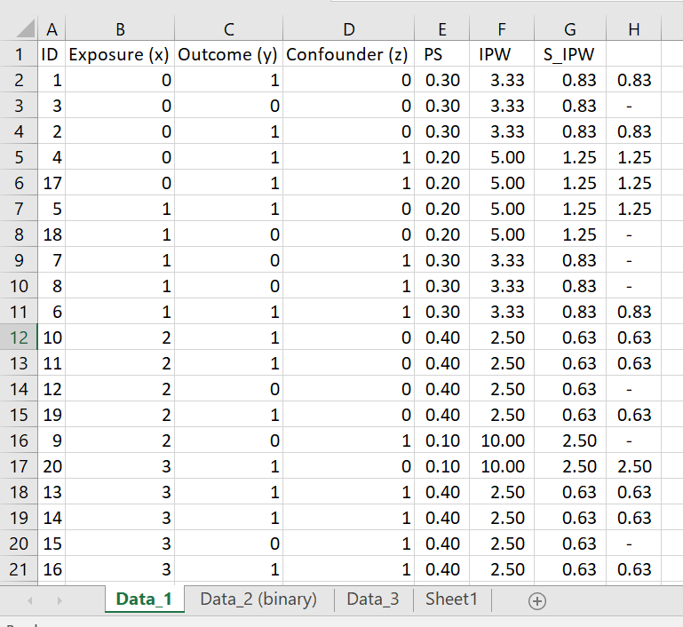

Slide 19
How to visualize PS’s?
Could try boxplots or density curves (e.g., EPID 722)
Want ATE, so want to see all curves

Slide 20
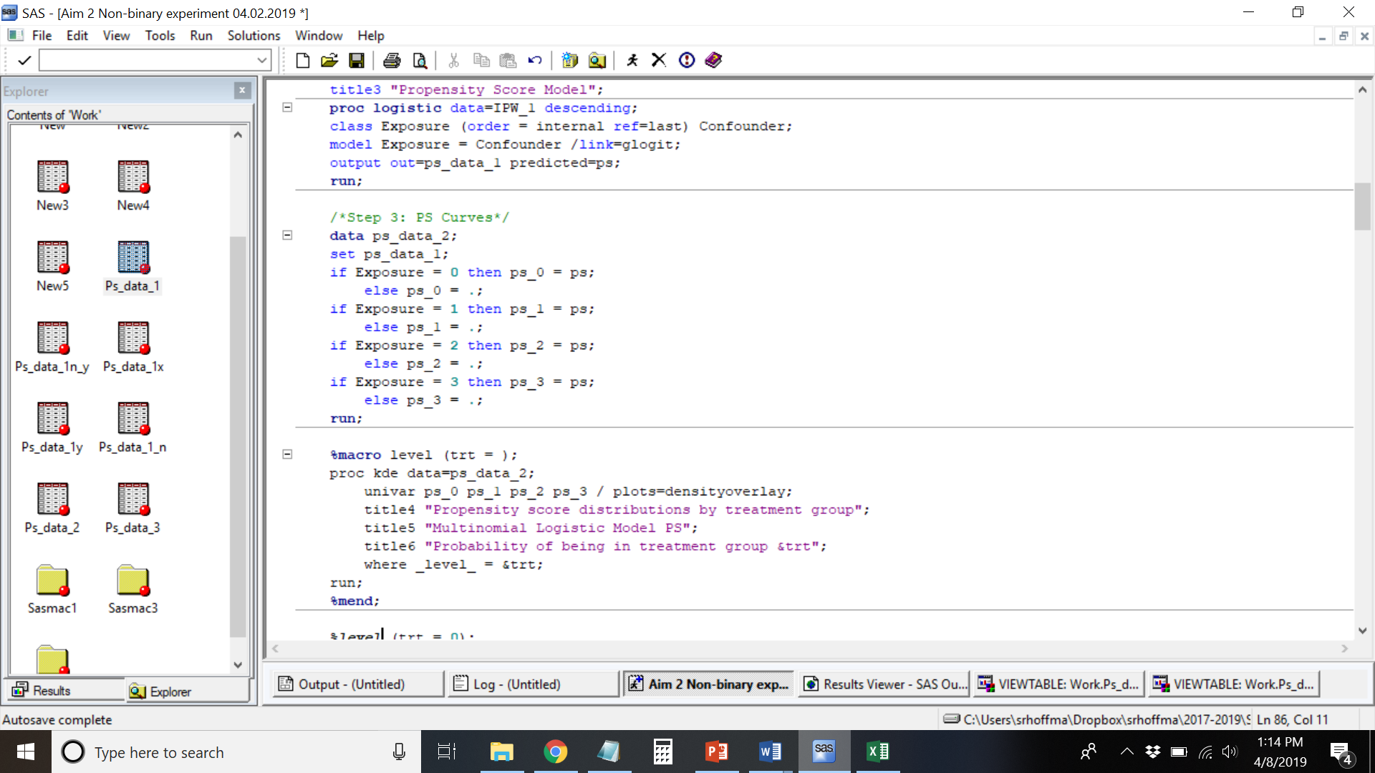
Notes:
Still keeping multiple lines per person

Slide 21
P(trt=0|covariates)

Slide 22
P(trt=1|covariates)

Slide 23
P(trt=2|covariates)

Slide 24
P(trt=3|covariates)
Notes:
Don’t want to mask bimodal distribution

Slide 25
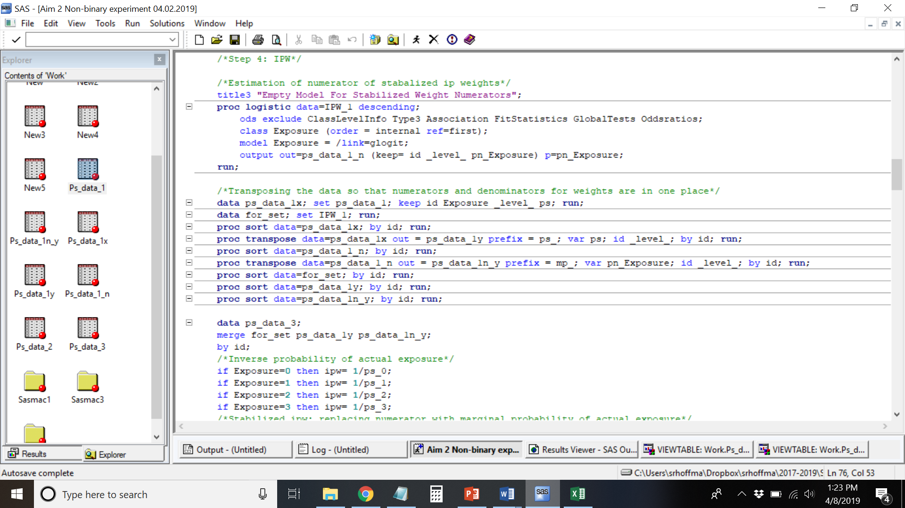
Data Gymnastics → Weights

Slide 26
Notes:
Same var name in different data set to indicate something else.

Slide 27
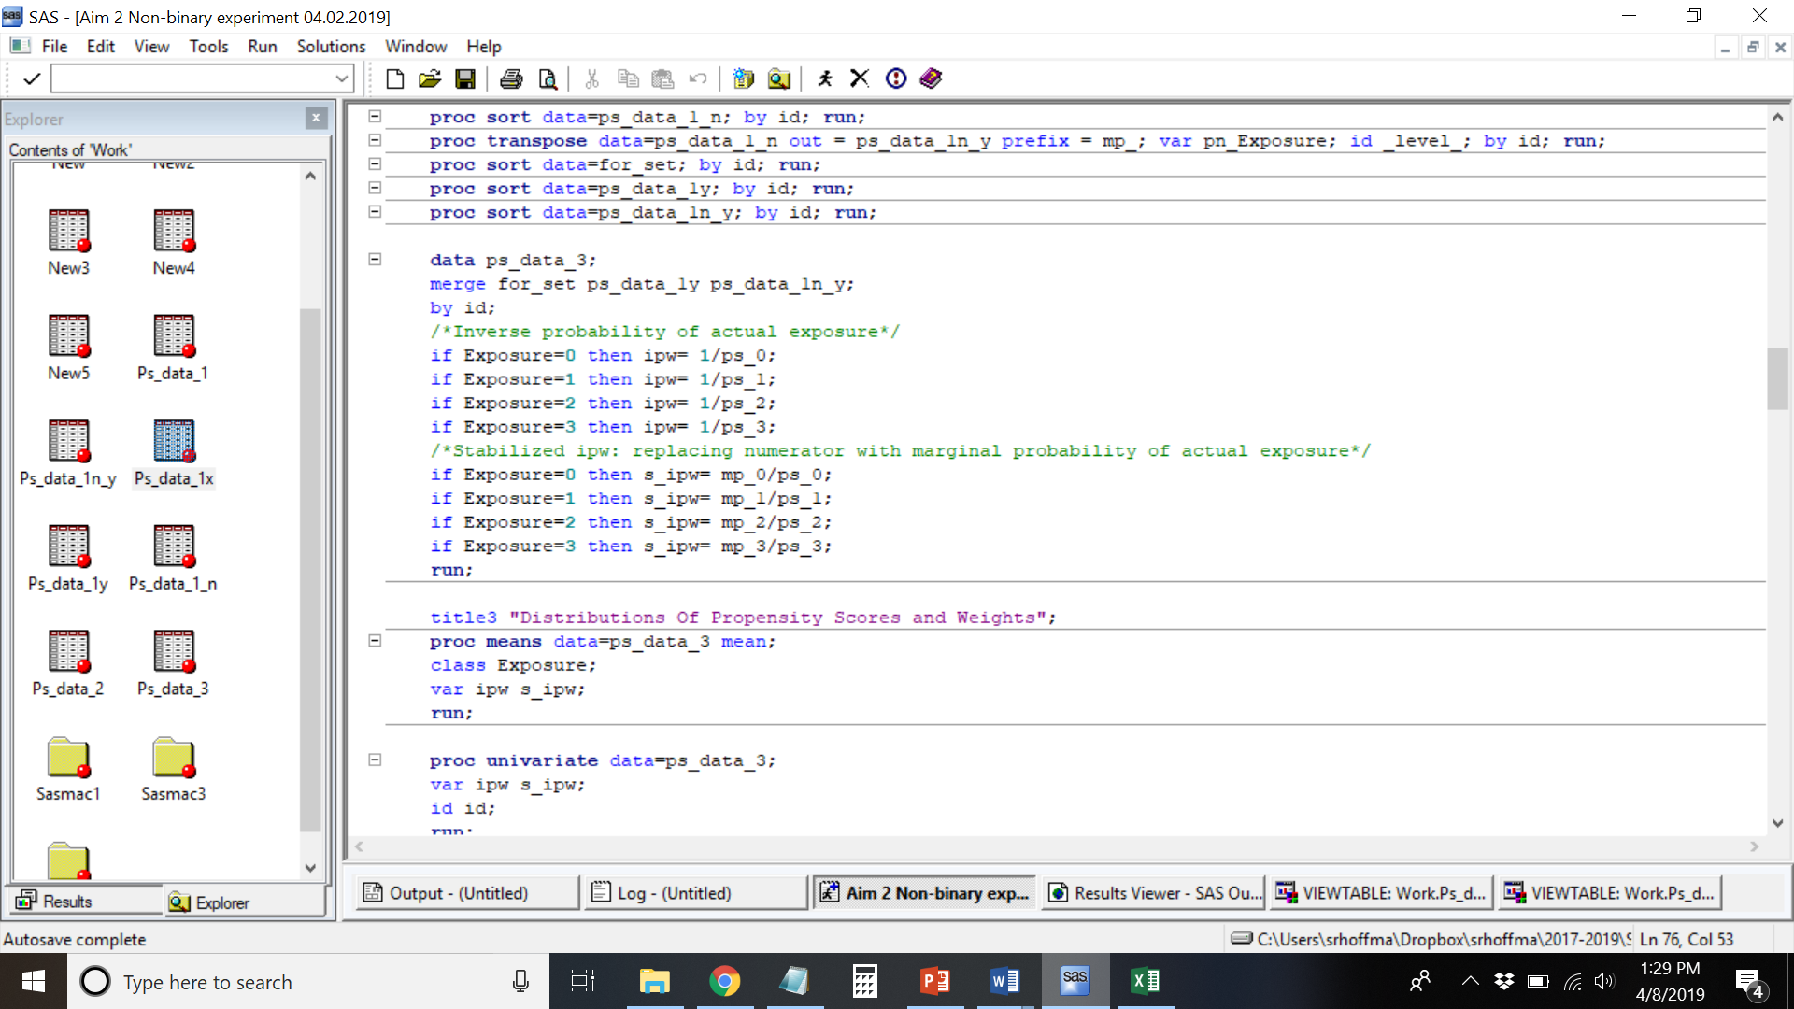
Calculation of Weights

Slide 28
Distribution of Weights

Slide 29
How to assess covariate balance?
Mean of the absolute standardized differences across all possible treatment comparisons
Could cancel out/mask imbalances. Could display each comparison. Think about which comparisons you are doing and present those.
Consider relevant comparisons…

Slide 30
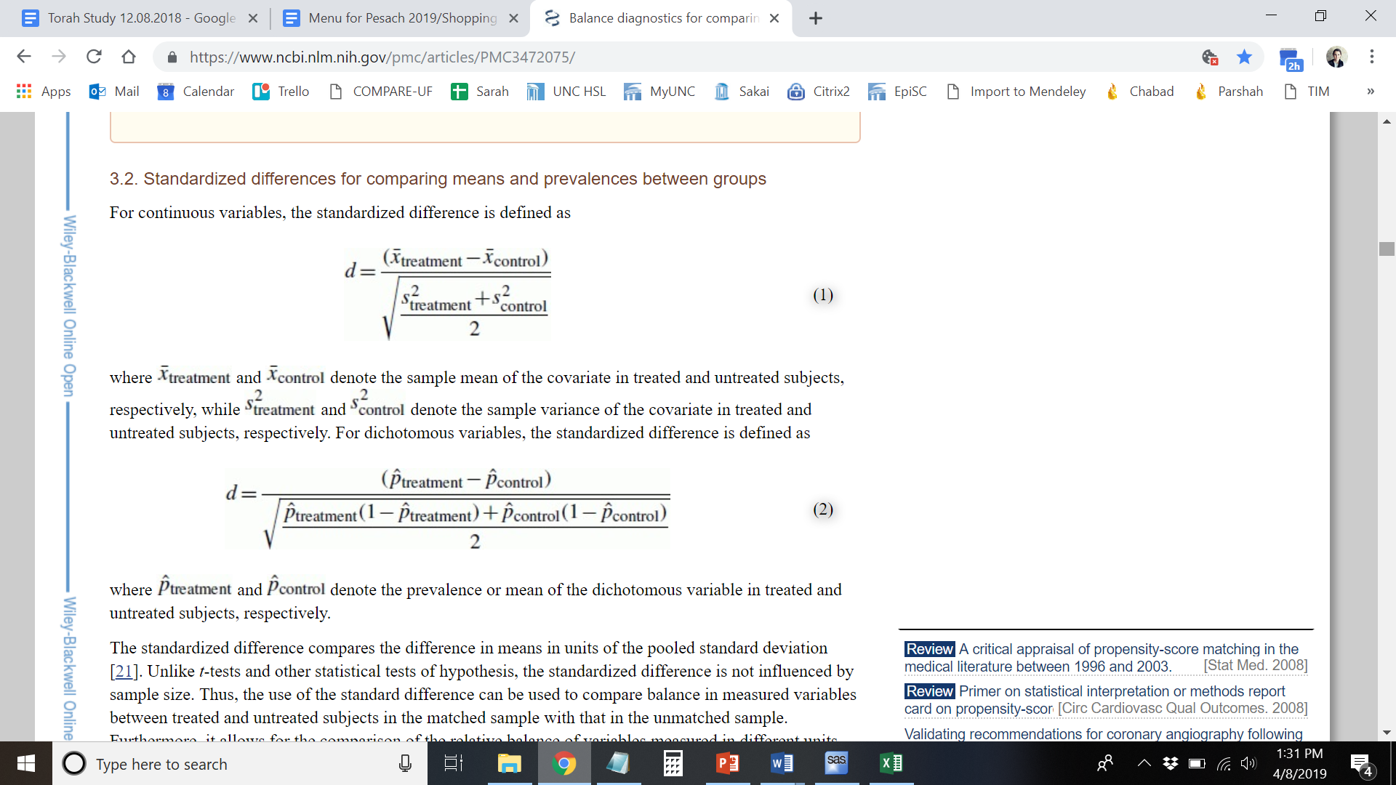
Absolute Standardized Difference
Austin PC. Balance diagnostics for comparing the distribution of baseline covariates between treatment groups in propensity-score matched samples. Stat Med. 2009;28(25):3083–3107. doi:10.1002/sim.3697
Notes:
Austin PC. Balance diagnostics for comparing the distribution of baseline covariates between treatment groups in propensity-score matched samples. Stat Med. 2009;28(25):3083–3107. doi:10.1002/sim.3697

Slide 31
Formula
Two PROC MEANS to output STD and MEAN
Merge output datasets
mean_abs_std_diff = round(mean(
abs((pct_1 - pct_0)/sqrt(((std_1*std_1) + (std_0*std_0))/2)),
abs((pct_1 - pct_2)/sqrt(((std_1*std_1) + (std_2*std_2))/2)),
abs((pct_1 - pct_3)/sqrt(((std_1*std_1) + (std_3*std_3))/2)),
abs((pct_2 - pct_0)/sqrt(((std_2*std_2) + (std_0*std_0))/2)),
abs((pct_2 - pct_3)/sqrt(((std_2*std_2) + (std_3*std_3))/2)),
abs((pct_3 - pct_0)/sqrt(((std_3*std_3) + (std_0*std_0))/2))
), .001);

Slide 32
Covariate Balance Assessment
Unweighted
IPW Weighted
S_IPW Weighted

Slide 33
What This Looks Like With More Data…
S_IPW Weighted
Notes:
Currently exploring other ways of doing this.

Slide 34
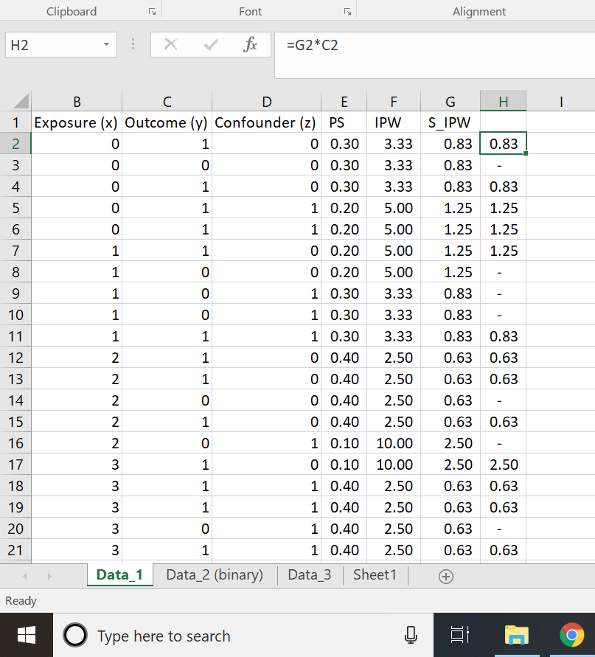
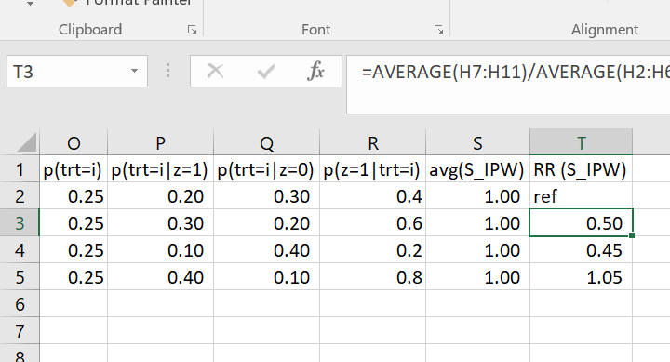
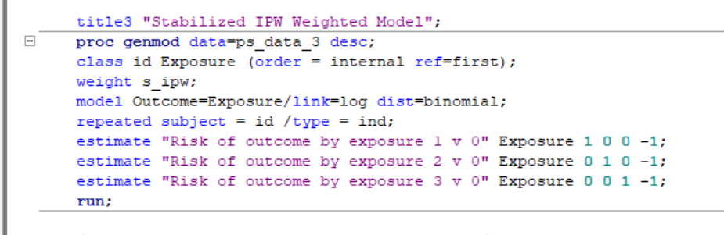
Weighted Estimates

Slide 35
RR’s with 95% CI’s
 | SAS | Excel/By Hand
Crude | 1v0: 0.50 (0.16, 1.59) 2v0: 0.75 (0.32, 1.74) 3v0: 1.00 (0.54, 1.86) | 1v0: 0.50 2v0: 0.75 3v0: 1.00
MVLR | 1v0: 0.59 (0.16, 2.19) 2v0: 0.83 (0.33, 2.04) 3v0: 1.26 (0.31, 5.05)
IPW | 1v0: 0.50 (0.16, 1.54) 2v0: 0.45 (0.12, 1.63) 3v0: 1.05 (0.66, 1.67)
S_IPW | 1v0: 0.50 (0.16, 1.54) 2v0: 0.45 (0.12, 1.63) 3v0: 1.05 (0.66, 1.67) | 1v0: 0.50 2v0: 0.45 3v0: 1.05

Slide 36
RR’s with 95% CI’s
 | SAS | Excel/By Hand
Crude | 1v0: 0.50 (0.16, 1.59) 2v0: 0.75 (0.32, 1.74) 3v0: 1.00 (0.54, 1.86) | 1v0: 0.50 2v0: 0.75 3v0: 1.00
MVLR | 1v0: 0.59 (0.16, 2.19) 2v0: 0.83 (0.33, 2.04) 3v0: 1.26 (0.31, 5.05)
IPW | 1v0: 0.50 (0.16, 1.54) 2v0: 0.45 (0.12, 1.63) 3v0: 1.05 (0.66, 1.67)
S_IPW | 1v0: 0.50 (0.16, 1.54) 2v0: 0.45 (0.12, 1.63) 3v0: 1.05 (0.66, 1.67) | 1v0: 0.50 2v0: 0.45 3v0: 1.05

Slide 37
RR’s with 95% CI’s
 | SAS | Excel/By Hand
Crude | 1v0: 0.50 (0.16, 1.59) 2v0: 0.75 (0.32, 1.74) 3v0: 1.00 (0.54, 1.86) | 1v0: 0.50 2v0: 0.75 3v0: 1.00
MVLR | 1v0: 0.59 (0.16, 2.19) 2v0: 0.83 (0.33, 2.04) 3v0: 1.26 (0.31, 5.05)
IPW | 1v0: 0.50 (0.16, 1.54) 2v0: 0.45 (0.12, 1.63) 3v0: 1.05 (0.66, 1.67)
S_IPW | 1v0: 0.50 (0.16, 1.54) 2v0: 0.45 (0.12, 1.63) 3v0: 1.05 (0.66, 1.67) | 1v0: 0.50 2v0: 0.45 3v0: 1.05

Slide 38
A Real Life Example (n=953)
MVLR
Contrast Estimate Results
Label | Mean Estimate | Mean |  | L'Beta Estimate | Standard Error | Alpha | L'Beta |  | Chi-Square | Pr > ChiSq
 |  | Confidence Limits |  |  |  |  | Confidence Limits
Risk of fibroids by duration of use: 1-1.99 yrs v <12mos | 1.1634 | 0.8070 | 1.6773 | 0.1514 | 0.1866 | 0.05 | -0.2144 | 0.5172 | 0.66 | 0.4173
Risk of fibroids by duration of use 2-4.99 yrs v <12mos | 1.2549 | 0.9087 | 1.7330 | 0.2271 | 0.1647 | 0.05 | -0.0958 | 0.5499 | 1.90 | 0.1680
Risk of fibroids by duration of use 5+ yrs v <12mos | 1.0955 | 0.7890 | 1.5210 | 0.0912 | 0.1674 | 0.05 | -0.2369 | 0.4194 | 0.30 | 0.5859
S_IPW Weighted
Contrast Estimate Results
Label | Mean Estimate | Mean |  | L'Beta Estimate | Standard Error | Alpha | L'Beta |  | Chi-Square | Pr > ChiSq
 |  | Confidence Limits |  |  |  |  | Confidence Limits
Risk of fibroids by duration of use: 1-1.99 yrs v <12mos | 1.2088 | 0.8272 | 1.7664 | 0.1896 | 0.1935 | 0.05 | -0.1897 | 0.5689 | 0.96 | 0.3272
Risk of fibroids by duration of use 2-4.99 yrs v <12mos | 1.2495 | 0.8955 | 1.7435 | 0.2228 | 0.1700 | 0.05 | -0.1104 | 0.5559 | 1.72 | 0.1900
Risk of fibroids by duration of use 5+ yrs v <12mos | 1.0246 | 0.7235 | 1.4510 | 0.0243 | 0.1775 | 0.05 | -0.3237 | 0.3723 | 0.02 | 0.8912

Slide 39
A Real Life Example (n=953)
MVLR
Contrast Estimate Results
Label | Mean Estimate | Mean |  | L'Beta Estimate | Standard Error | Alpha | L'Beta |  | Chi-Square | Pr > ChiSq
 |  | Confidence Limits |  |  |  |  | Confidence Limits
Risk of fibroids by duration of use: 1-1.99 yrs v <12mos | 1.1634 | 0.8070 | 1.6773 | 0.1514 | 0.1866 | 0.05 | -0.2144 | 0.5172 | 0.66 | 0.4173
Risk of fibroids by duration of use 2-4.99 yrs v <12mos | 1.2549 | 0.9087 | 1.7330 | 0.2271 | 0.1647 | 0.05 | -0.0958 | 0.5499 | 1.90 | 0.1680
Risk of fibroids by duration of use 5+ yrs v <12mos | 1.0955 | 0.7890 | 1.5210 | 0.0912 | 0.1674 | 0.05 | -0.2369 | 0.4194 | 0.30 | 0.5859
S_IPW Weighted
Contrast Estimate Results
Label | Mean Estimate | Mean |  | L'Beta Estimate | Standard Error | Alpha | L'Beta |  | Chi-Square | Pr > ChiSq
 |  | Confidence Limits |  |  |  |  | Confidence Limits
Risk of fibroids by duration of use: 1-1.99 yrs v <12mos | 1.2088 | 0.8272 | 1.7664 | 0.1896 | 0.1935 | 0.05 | -0.1897 | 0.5689 | 0.96 | 0.3272
Risk of fibroids by duration of use 2-4.99 yrs v <12mos | 1.2495 | 0.8955 | 1.7435 | 0.2228 | 0.1700 | 0.05 | -0.1104 | 0.5559 | 1.72 | 0.1900
Risk of fibroids by duration of use 5+ yrs v <12mos | 1.0246 | 0.7235 | 1.4510 | 0.0243 | 0.1775 | 0.05 | -0.3237 | 0.3723 | 0.02 | 0.8912

Slide 40
A Journey

Slide 41
Next…
Attempt with non-binary confounders using dissertation data!
Refine covariate balance assessment approach
Consider why S_IPW weighted SMD bigger than IPW weighted SMD
Try for ATT
Notes:
for ATT, multiply weights by the ps, rendering exposed as 1

Slide 42
Thank You!
Alex Breskin
Mitch Conover
Ashley Naimi
Rebecca Stebbins
Committee Members
Quaker Harmon
Charlie Poole
Michael Hudgens
Michele Jonsson Funk
Notes:
Committee Members who helped with this!

Slide 43
Contact Information for Code/Excel
srhoffma@live.unc.edu
https://github.com/srhoffma/non_binary_exposure_IPW.git

Slide 44
The End

Slide 45
Look at max weights as well
Why SIPW bigger MSD?
ATE (average treatment effect) -- such that if the entire population had received treatment i compared to all of the study population receiving treatment 0
ATT multiply weights by the ps, rendering exposed as 1

Slide 46
Three Helpful Papers (And How I Got Them)
Niami (via Poole)
Reporting (via Hudgens)
Example (via SER Digital chat window)
Notes:
Take what you need. Let each paper speak to you uniquely for where you are at on your quest. (1) What kind of model to use to estimate PS. (2) A paradigm for thinking, a word bank of options. An overview. (3) Confirmation that I was right!

